Slide 1
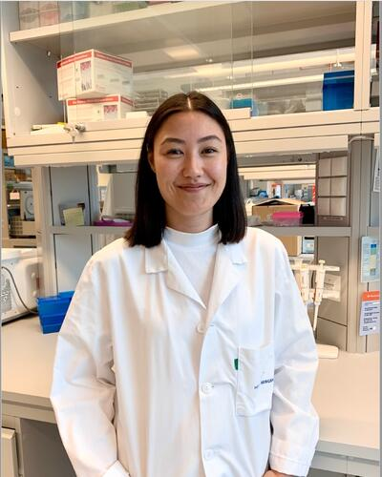

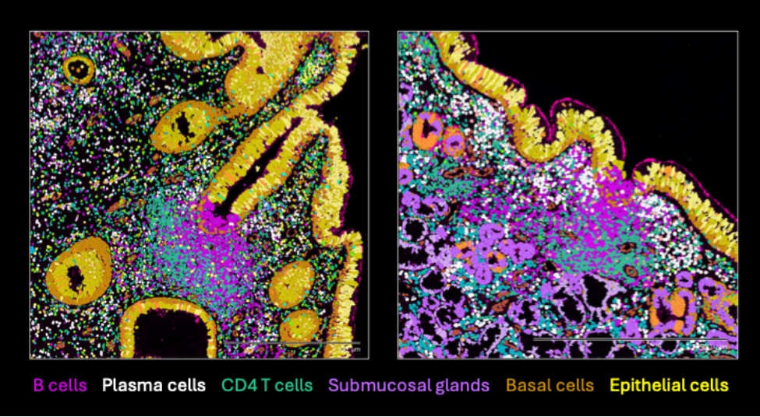

UiB open lecture
Tertiary lymphoid follicles in the human nasal mucosa are inductive sites for humoral immunity
LENA HANSEN
Thursday 15.05.25
15:00 – 16:00
AUDITORIUM D302,
SENTRALBLOKKEN
Lena Hansen (PhD) is a former doctoral student at the Influenza Centre, UiB. She is currently a post doc at the Guthmiller Lab,Univeristy of Colorado, USA.
The talk focuses on her research using the Xenium in situ platform to examine spatial distribution of immune cells within tissues of the nasal mucosa from subjects with chronic sinusitis. Her work documents for the first time the structure of tertiary lymphoid follicle located beneath the epithelial barrier of the nasal cavity that serve as key sites for initiating humoral immune responses.
Everyone welcome!
Arranged by the Influenza Centre UiB

