Slide 1
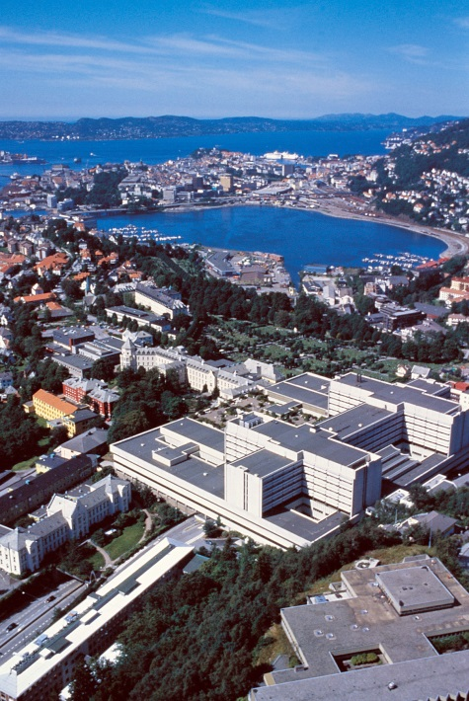
C
B
S
C
Inauguration of Bergen Stem Cell Consortium
You are hereby invited to a symposium organized to mark the establishment of the Bergen Stem Cell Consortium.
When: Monday September 1, 2014:
12³⁰-17⁰⁰.
Where: Room B301 (Central Building)
The Consortium is a joint scientific enterprise to establish an ex vivo lab capable of establishing stem cell treatments at Haukeland University Hospital
Program: see reverse
On behalf of the organizers,
Einar K. Kristoffersen

Slide 2
Tentative meeting agenda:
Chair: Helge Ræder / Kamal Mustafa
1230-1300: Finger food
1300-1305: Welcome by Gunnar Mellgren
1305-1320: Inauguration of BSCC. CEO Kvinnsland
1320-1330: The role of the University. Nina Langeland
1330-1410: Experience with ex vivo lab in Milan. Rosaria.
1410-1430: Experience with ex vivo lab in Oslo. Brinchmann
1430-1500: Diabetes stem cells. Kulkarni, Harvard Stem Cell Consortium
1500-1530: Coffee break
1530-1700: Presentation by Consortium members.
1530-1540: Introduction of Consortium (Members, Infrastructure). 1540-1550: Mustafa
1550-1600: Beisland/Kalland group
1610-1620: Raeder
1620-1630: Bindoff
1630-1640: Hervig/Melve/Kristoffersen/ Stavanger group
1640-1650: Bjørn Tore Gjertsen
1700: Closure by Einar Kristoffersen

