Slide 1
HSE non-conformities
To be used on digital information displays

Slide 2
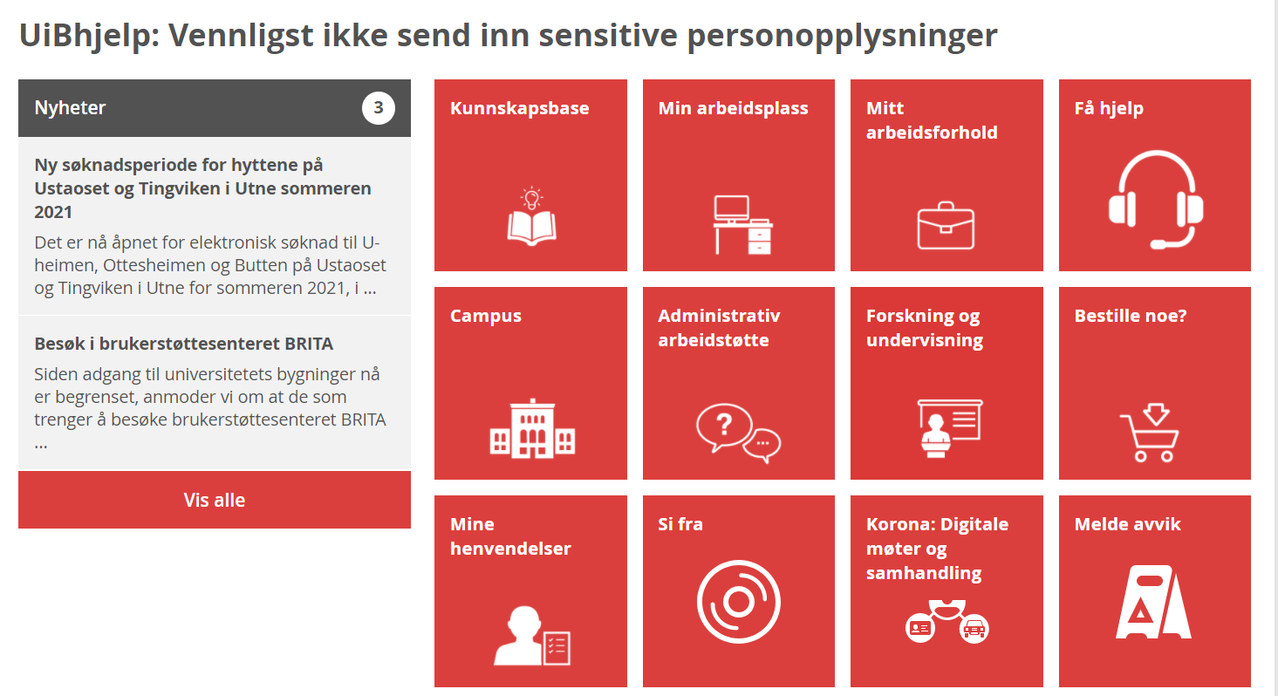
Report HSE non-conformities in UiBhjelp
Employees and students must report HSE non-conformities in UiBhjelp: hjelp.uib.no
Wondering what HSE non-conformities are?
It may be:
conditions that reduce fire safety
theft or vandalism
a personal injury that occurs on campus

Slide 3

Theft or vandalism?
Theft or vandalism on campus?
It must be reported as a HSE non-conformity, in order to ensure proper follow up.
Report HSE non-conformities in UiBhelp: hjelp.uib.no

Slide 4

Coffee maker without timer?
Do you see a coffee maker or kettle without a timer?
Both this and other fire hazards must be reported as a non-conformity, in order to ensure proper follow up.
Report HSE non-conformities in UiBhelp: hjelp.uib.no

Slide 5

Personal injury on campus?
Did you get injured on campus?
It must be reported as a non-conformity, in order to ensure proper follow up.
Report HSE non-conformities in UiBhelp: hjelp.uib.no

Slide 6

Blocked emergency exits?
Are there boxes or other objects in front of emergency exits and escape routes?
It must be reported as a HSE non-conformity, in order to ensure proper follow up.
Report HSE non-conformities in UiBhelp: hjelp.uib.no

Slide 7

Chemical spills?
Have there been an accident with chemicals in the lab?
It must be reported as a HSE non-conformity, in order to ensure proper follow up.
Report HSE non-conformities in UiBhelp: hjelp.uib.no

Slide 8


Cut from broken glass?
Have you had an accident and cut yourself on broken glass?
It must be reported as a HSE non-conformity, in order to ensure proper follow up.
Report HSE non-conformities in UiBhelp: hjelp.uib.no

Slide 9

Needles in residual waste?
Are there needles or other sharp objects in the residual waste?
It must be reported as a HSE non-conformity, in order to ensure proper follow up.
Report HSE non-conformities in UiBhelp: hjelp.uib.no

Slide 10

Fire damage?
Did you get a burn during the laboratory course?
It must be reported as a HSE non-conformity, in order to ensure proper follow up.
Report HSE non-conformities in UiBhelp: hjelp.uib.no

Slide 11

Is the emergency shower blocked?
Is access to the emergency shower restricted?
It must be reported as a HSE non-conformity, in order to ensure proper follow up.
Report HSE non-conformities in UiBhelp: hjelp.uib.no

Slide 12
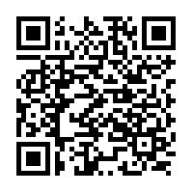
Personal injury at UiB?
You may scan the QR-code to get directly to the HSE non-conformity form.
You may also find the form at UiBhelp: hjelp.uib.no

Slide 13
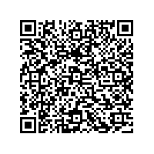
HSE non-conformity?
You may scan the QR-code to get directly to the form.
You may also find the form at UiBhelp: hjelp.uib.no

