Slide 1
Introduction for and discussion with the leader group at the Faculty of Medicine
Hiroshi MATSUMOTO
representative of UiB in Japan
Innovation Norway Tokyo
Royal Norwegian Embassy in Tokyo

Slide 2
Roles of HM – my proposal
Interface between quite different/similar systems
Provide information on opportunities existing in Japan
Student exchanges and study/research in Japan
Unique and excellent competences / research infrastructure in Japan available for Norwegian researchers
Regular reporting on the progresses in Research and Innovations in Japan in requested areas
Assist Japanese partner search
In applying for Horizon 2020
In applying for Norwegian funding program
Communications activities in Japan to increase visibilities of NTNU
Attract good Japanese students coming to NTNU
Attract good NTNU students going to Japanese universities
Attract productive Japanese researchers to collaborate with NTNU
Assist negotiations, Follow-up of MOUs, agreements, and arrangements
Help Desk

Slide 3
merit of collaboration with Japan in the area of medicine and health research
Japan is the most advanced aging society
Health care studies for again society in view of reduction of the health care cost and the gap between average life expectancy and health age is the highest priority of the governmental research policy and support.
Application of ICT technologies and robotics to health care is highly getting attention.
Many biobank projects are staring up in Japan.
Tohoku Medical Megabank Project at Tohoku University received huge funding in a context of governmental support for the recovery of Tohoku region after the great earthquake in 2011.
Rapid development / application of iPS cell technologies at Kyoto University and Riken is attracting collaborations from all over the world.

Slide 4
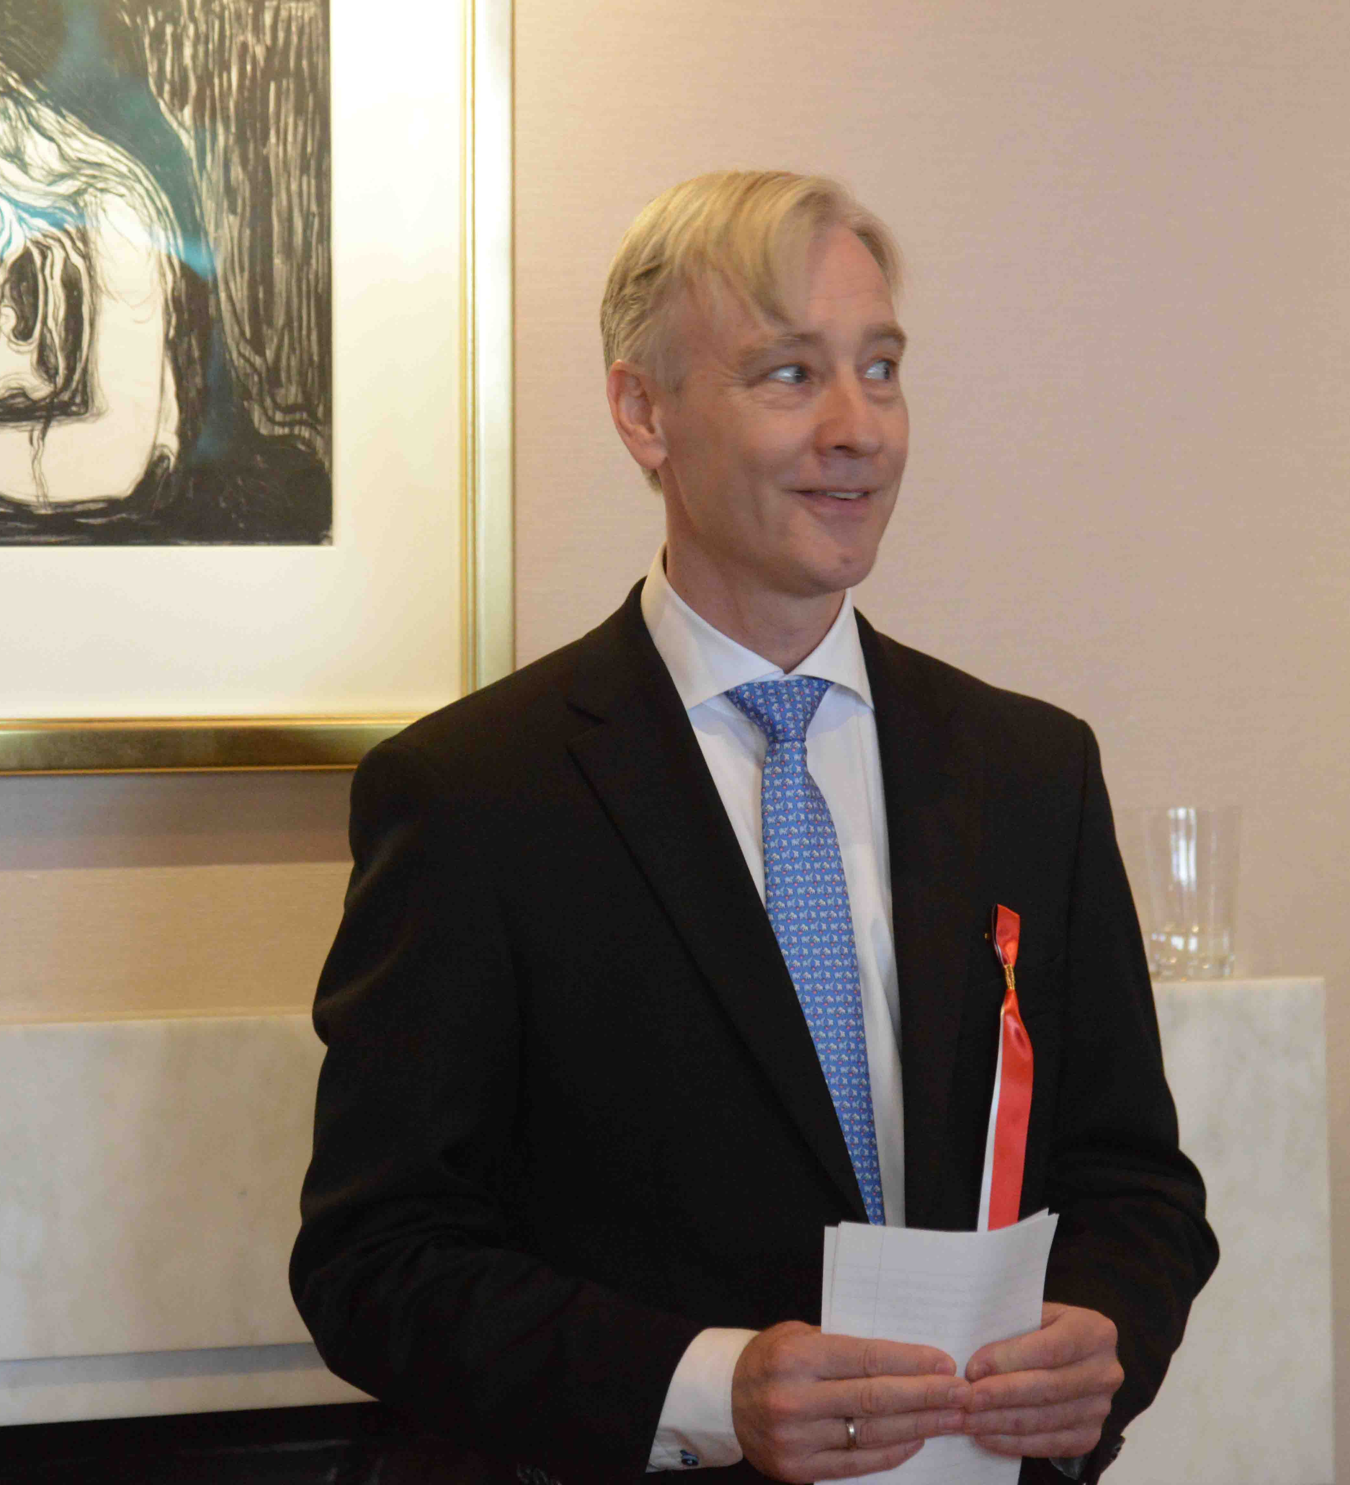
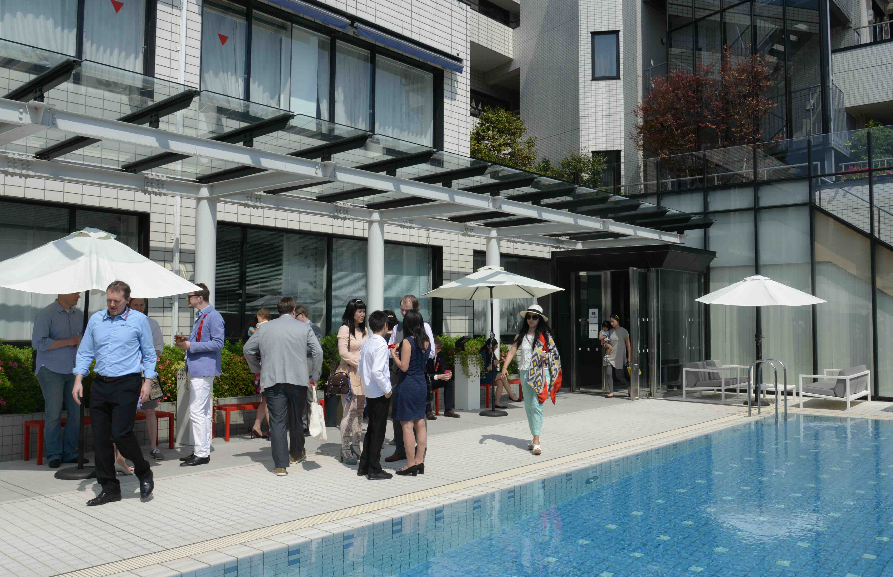
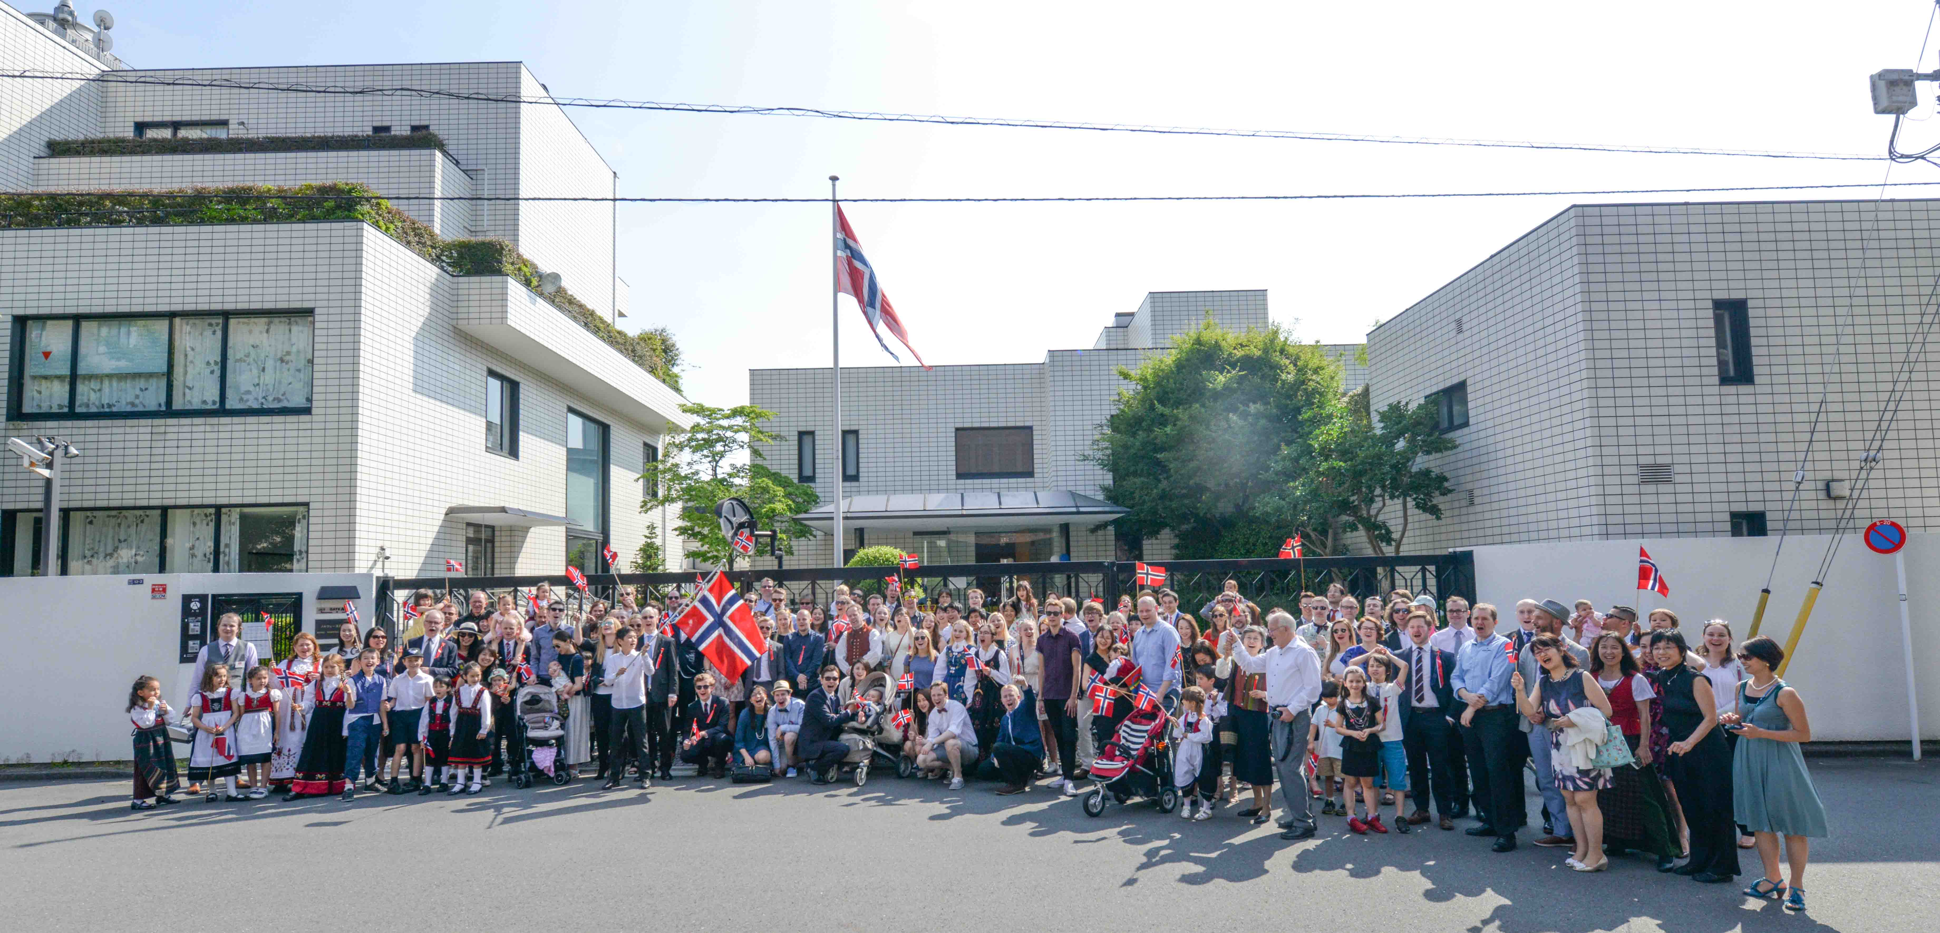
Innovation Norway Tokyo at Royal Norwegian Embassy
The Embassy has:
Aurora Hall which can accommodate around 100 people for meetings, seminars, and workshop.
Meeting rooms and temporary office space with desk, computer and internet connections for short time visit.
The Embassy can host receptions /dinners at the residence of the Ambassador

Slide 5

My previous work (1)
National Contact Point for Horizon 2020 in Japan
From 2014 to 2016
NCP Coordinator
NCP for ENERGY
NCP for materials
NCP for Health
NCP for ICT
network with University Research Administrators
network with Brussels
network with Japanese funding agencies
Consultation to MEXT, METI, MIC, and MOFA

Slide 6
My previous work (2)
2013 - 2014
Promotion of HPC use through the High Performance Computing Infrastructure in Japan
Call for proposals
Awarding of the computational resources
Dissemination of achievements / success stories

Slide 7
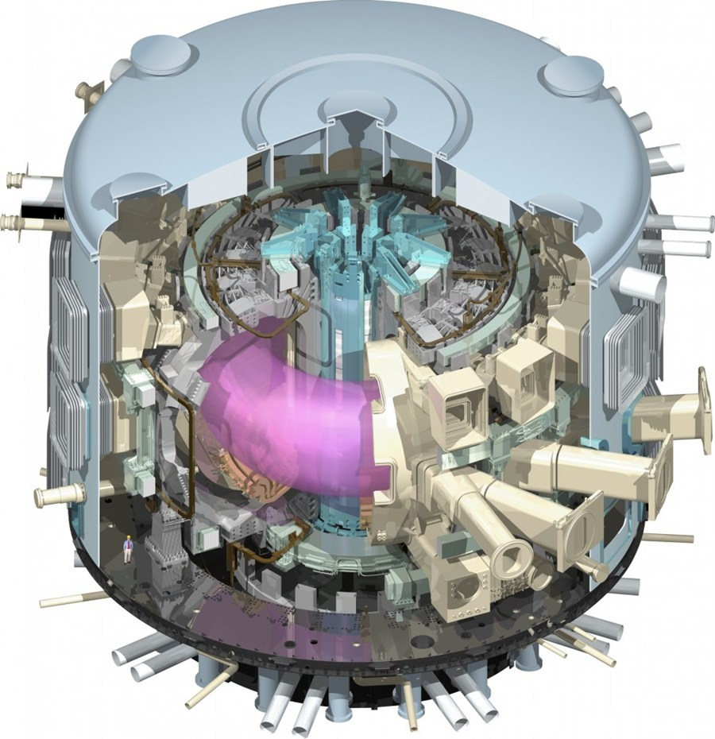
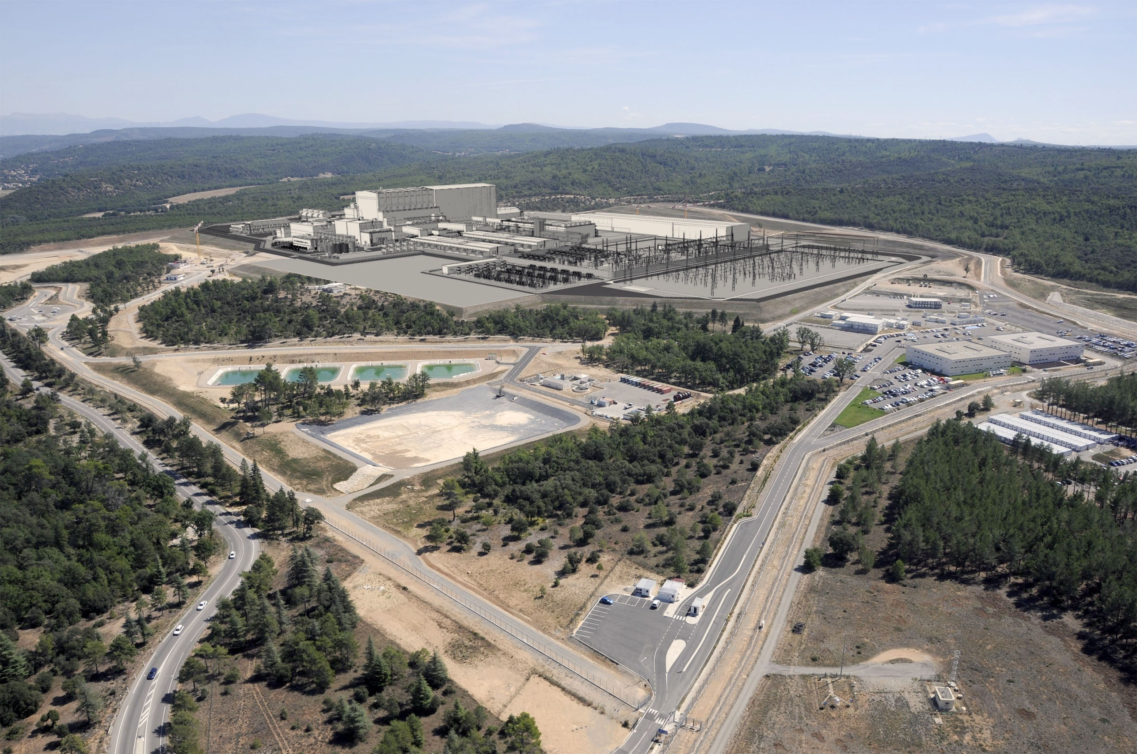
My previous work (3) : 30 years of work in Nuclear Fusion Research
1988 - 1992, US-Japan Research Collaboration in fusion research
Leader of Japanese Team
General Atomics, San Diego, California, US
1992-3013, ITER Project – international project, construction of the machine in France

Slide 8
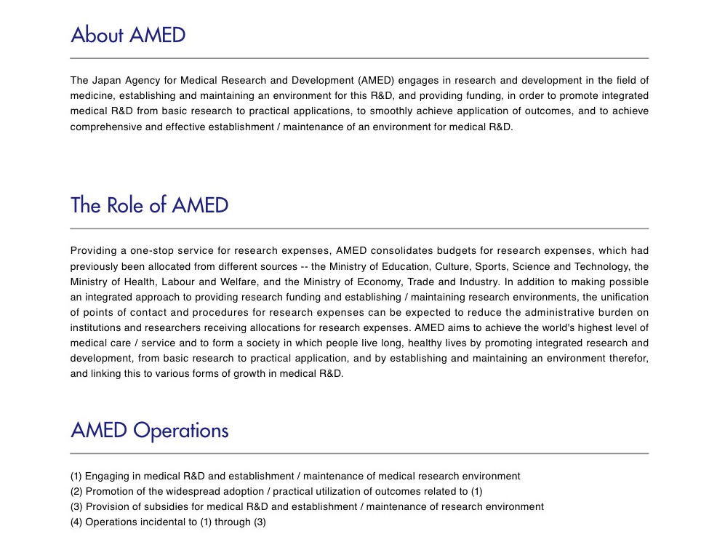
Start of Japan Agency for Medical Research and Development (AMED)

Slide 9
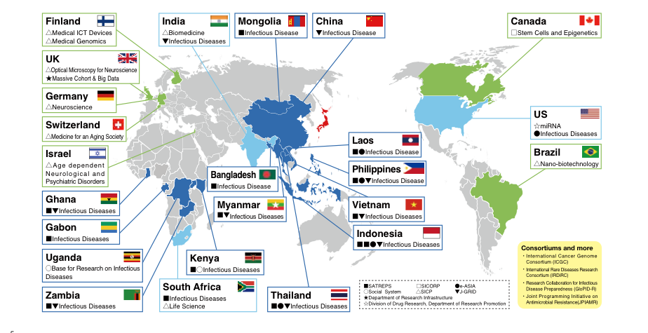
AMED International collaborations

Slide 10
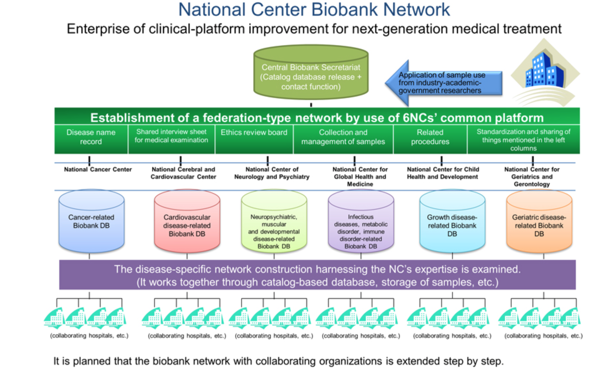
National Center Biobank Network: NBC Project http://www.ncbiobank.org/outline-e.html : National Center for Global Health and Medicine
The mission of National Research Centers for Advanced and Specialized Medical Care (National Center: NC), which consists of six National Centers (6NCs), is to explore and overcome particular diseases that have a significant impact on national health.

Slide 11
Tohoku University ToMMo Project : http://www.megabank.tohoku.ac.jp/english/

Slide 24
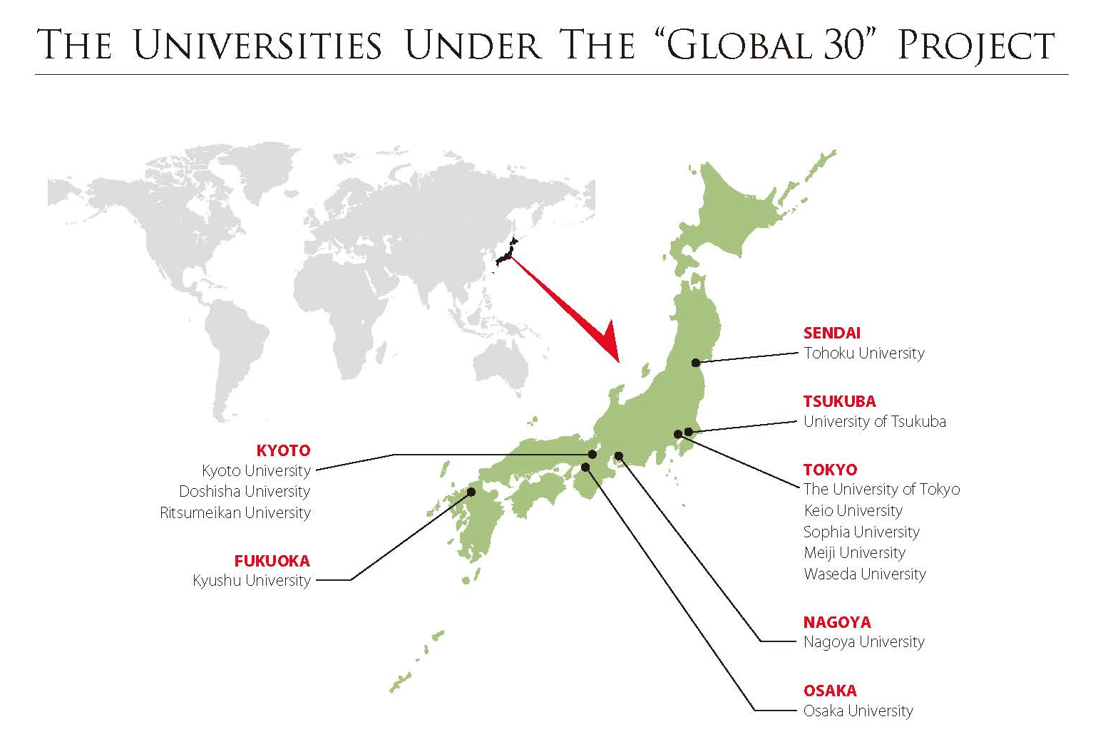
Study in Japan - Global 30 Project http://www.uni.international.mext.go.jp/study/
13 universities were selected by the Japanese Government to be a member of the "Global 30" Project.
These selected universities aim to nurture internationally competent individuals by creating an academic environment where international and Japanese students can learn from one another and build lasting international bonds that will propel them into the international scene.

Slide 25
My vision of UiB – Japan collaboration
Sound and robust institutional bilateral relation is a basis for further multilateral collaboration
Start with bilateral collaboration with small/seed funding.
Scale up to multilateral collaborations such as European Framework Programmes.
In many areas, consortium of Norwegian research entities constitutes a very attractive collaboration partner.
Norwegian perspective
Scandinavian perspective
European dimension
To create innovation and breakthroughs, Japanese and Norwegian researches can team up with complementary contributions.
We can share research infrastructure of each partner to avoid duplicated investment
Sending UiB Ph.D. students to Japan should be a strategically very important step to start-up / enlarge collaborations.

